Slide 1


Shock Tube Method for Dynamic Calibration of Pressure Transducers
Nina Mackey, Dr. Alex Craig, John Flood, Vincent Tran

Slide 2
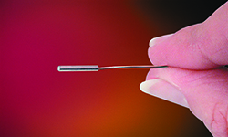
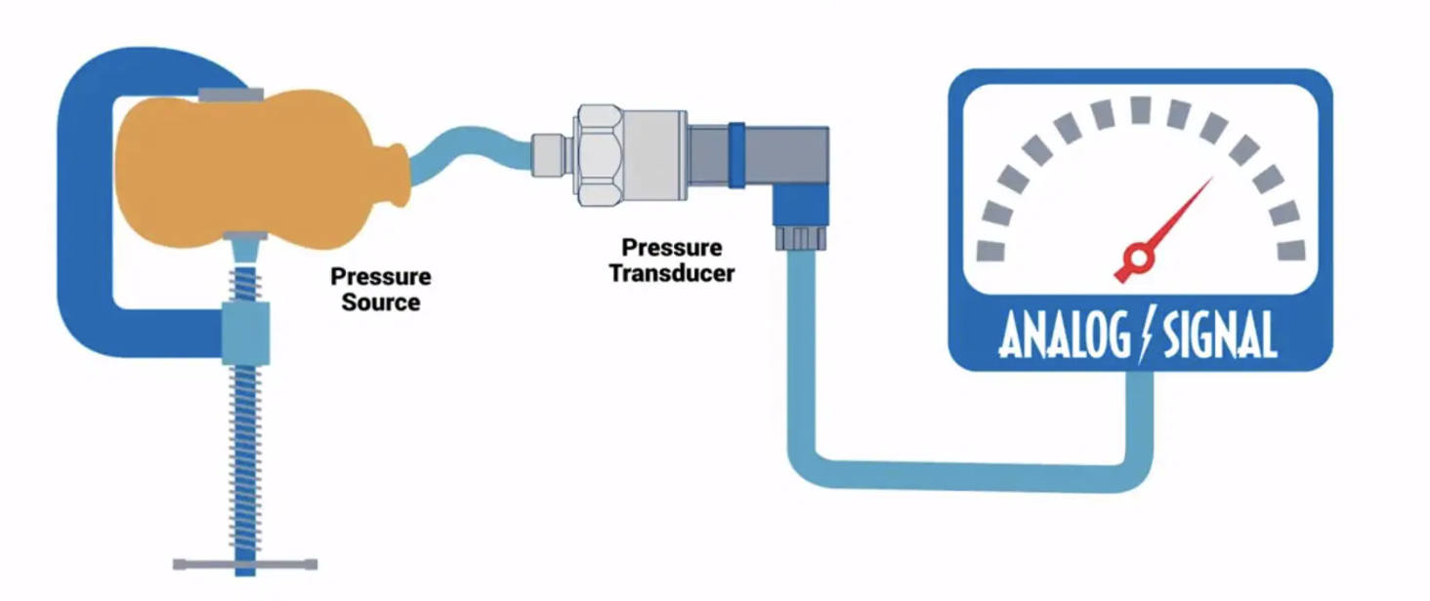
Pressure Transducer Background
Pressure sensor for gases and liquids
Kulite XCE-062
High Temperature Ultraminiature Pressure Transducer
Wide range of applications
Kulite.com
Omega.com

Slide 3
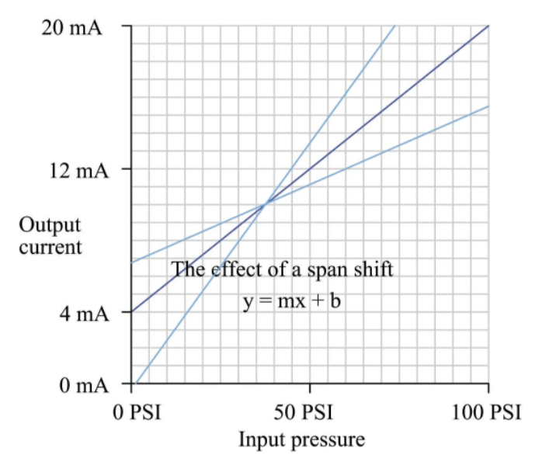
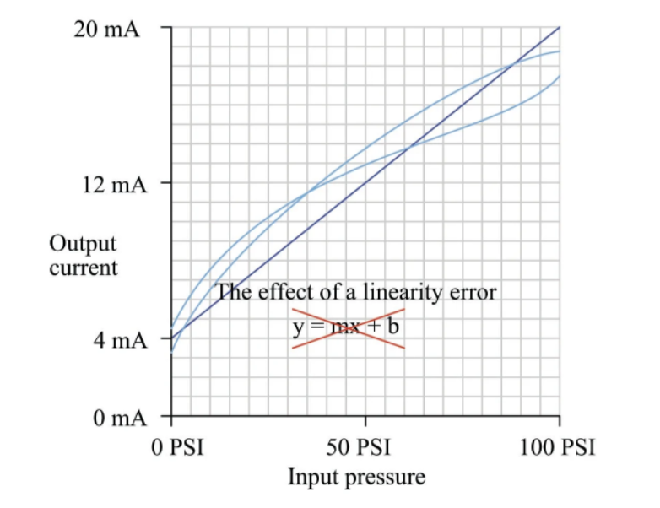
Pressure Transducer Calibration Importance
Often installed in harsh operating environments
Performance shift over time
Examples of calibration errors
Dynamic vs Static Calibration
Dynamic calibration determines
dynamic behavior of sensor
Shock Tube method chosen
Important to understand
unsteady flow features
Error Example 1
Error Example 2
Control.com
Control.com

Slide 4
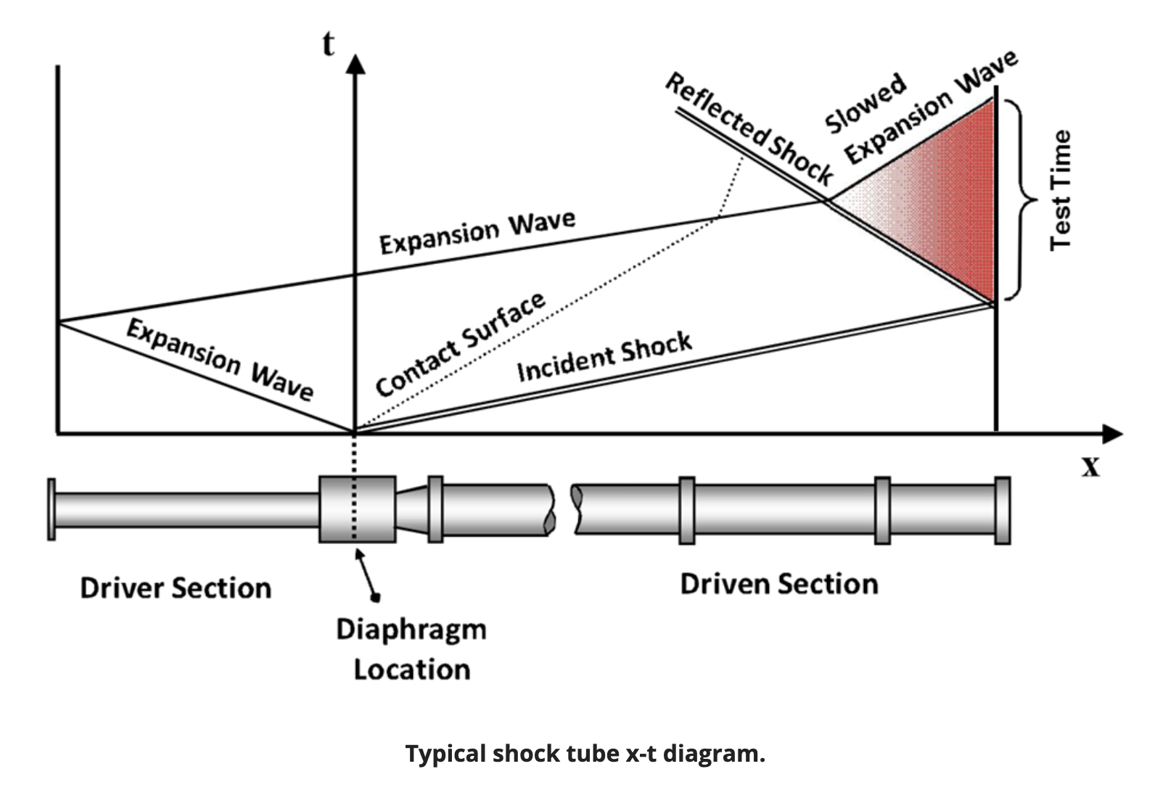
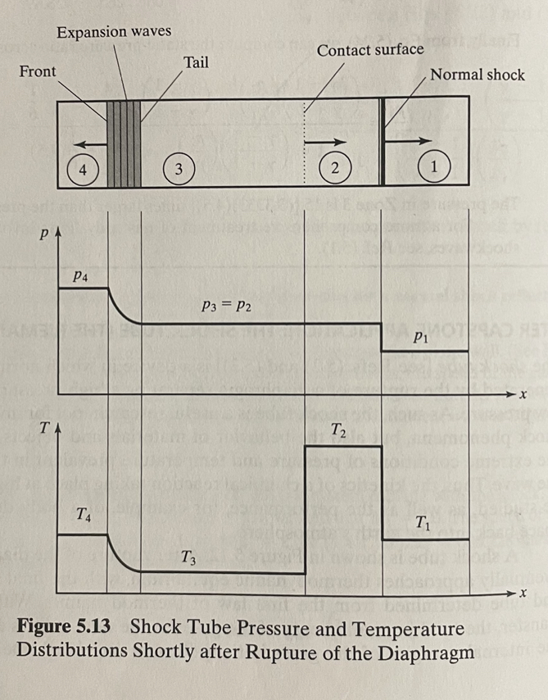
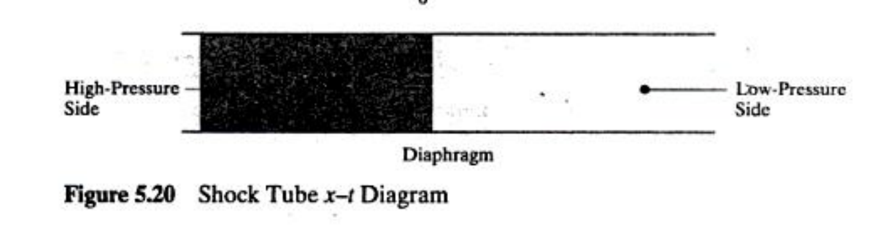
Shock Tube Background
Driver and Driven Sections
High pressure side, Low pressure side
Resulting shockwave
PetersonGroup.TAMU.edu
Keith and John, Gas Dynamics 3rd Edition
Keith and John, Gas Dynamics 3rd Edition

Slide 5
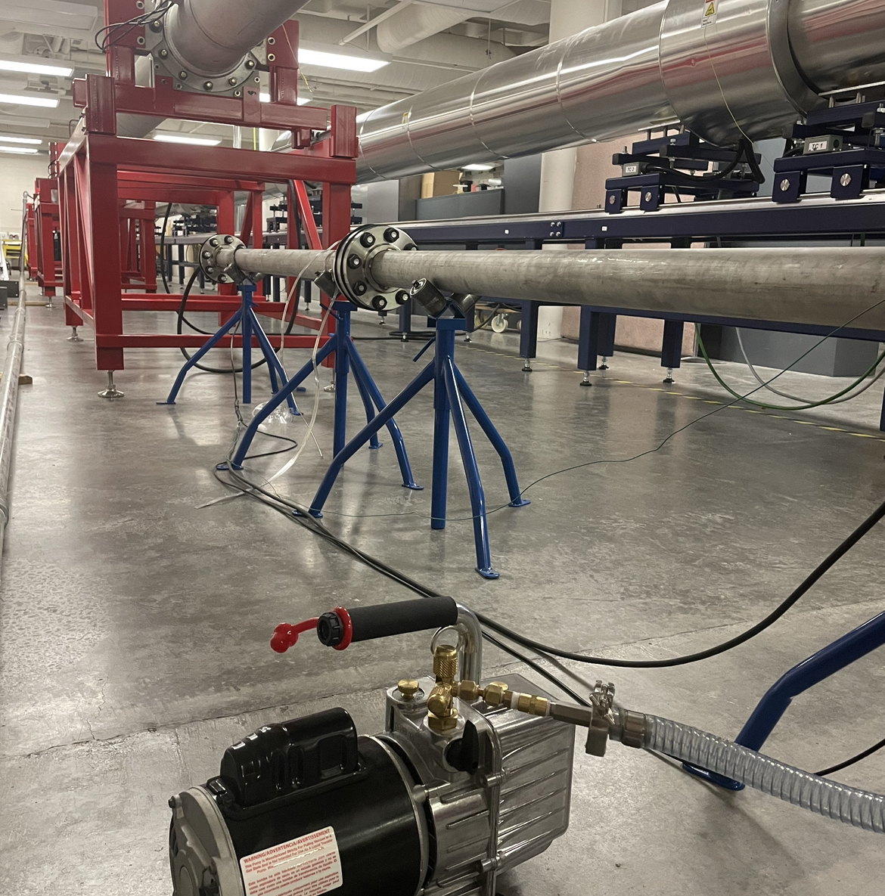
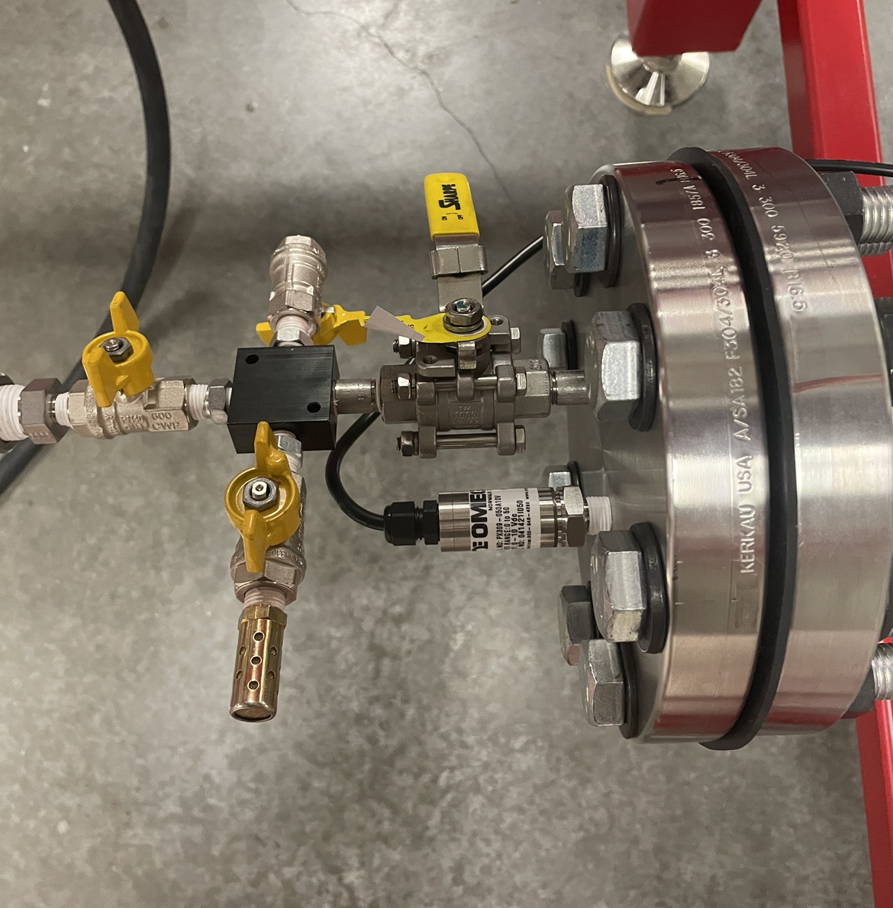
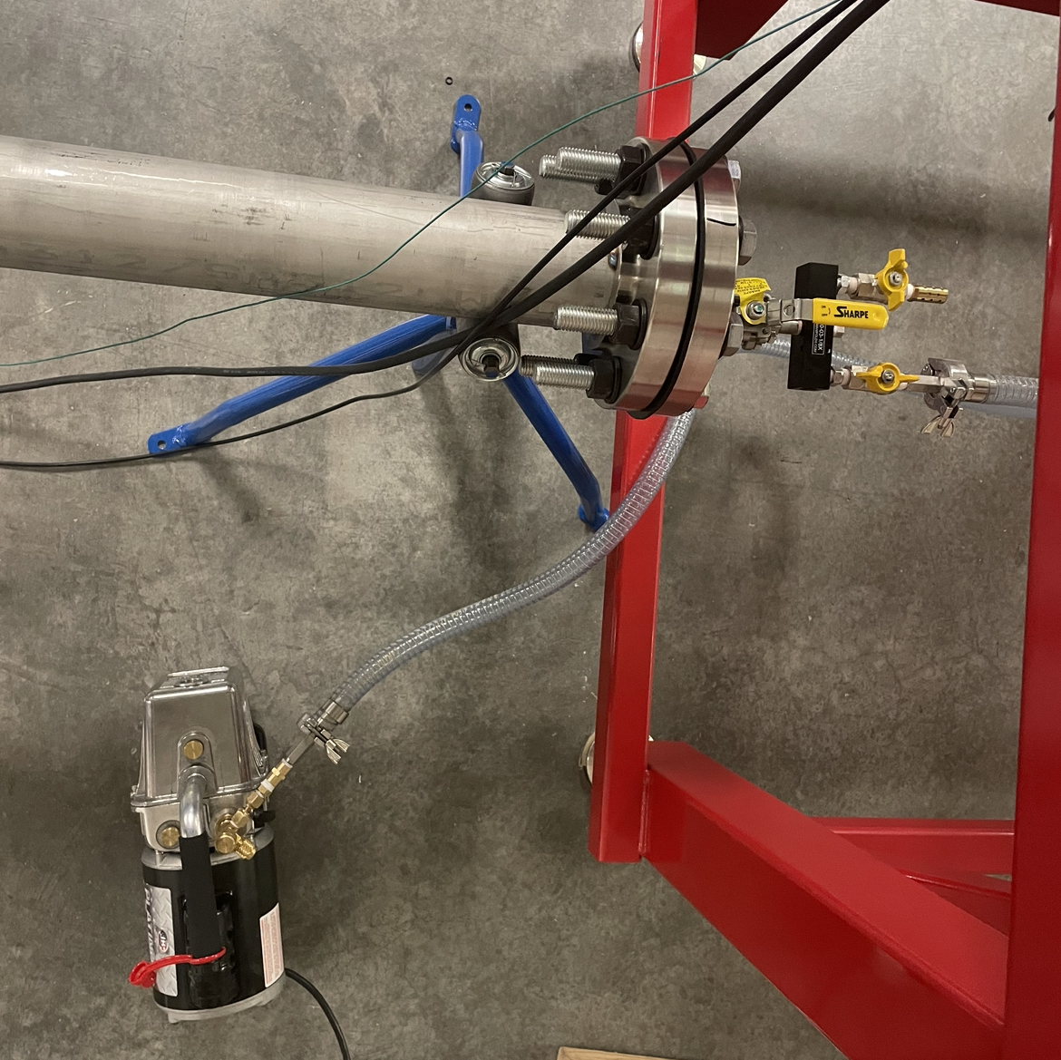
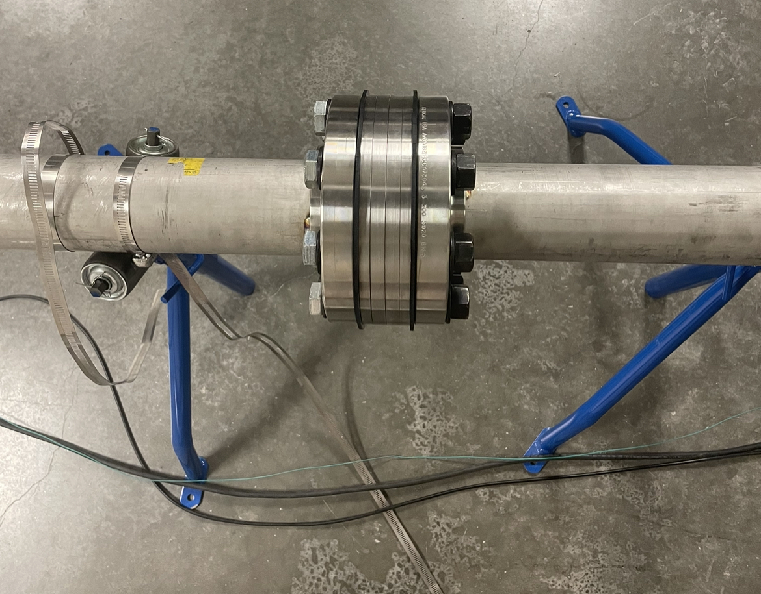
Shock Tube Design
Designed in SolidWorks
Adjustments made as parts were produced by shop
Mylar diaphragm
Tube is rated to 100 psi
Kulite measures 0-20 psi
Tube made of steel
Mounted pressure transducer
Within Driven section

Slide 6
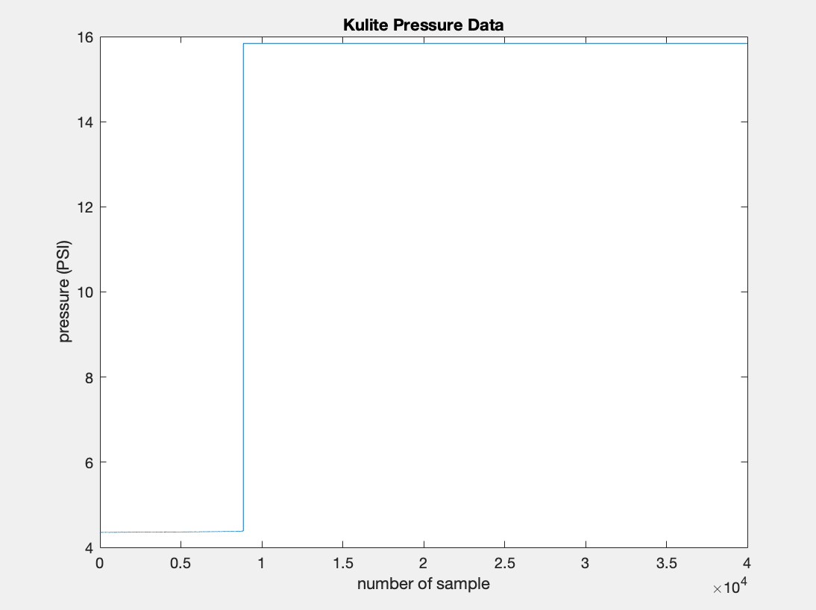
Results
Pressure transducer experiences a step change in input
MATLAB used to process data
Produces graphs, most important being Kulite Pressure Data
Sources of error

Slide 7
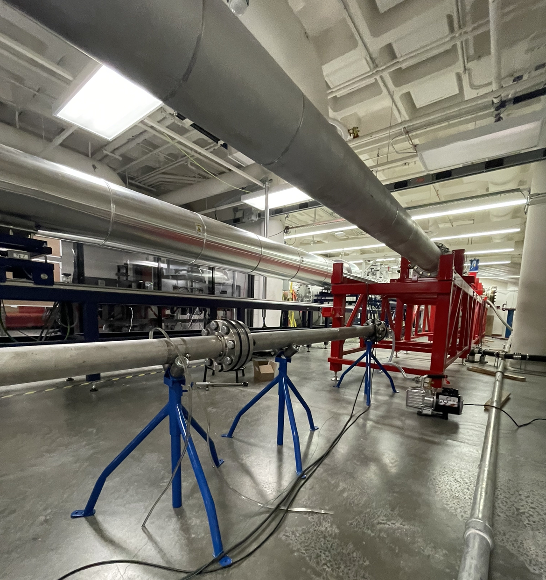
Summary
Over time, errors can be analyzed to improve design
Importance of this project within BLST Lab and beyond
Future applications
Applicable in wide range of pressure transducer usage

Slide 8
Thank You!

